Slide 1
Heavenly Intent

Slide 2
Note: Any videos in this presentation will only play online. After you download the slideshow, you will need to also download the videos from YouTube & add them back into your PowerPoint.
We present these messages at Bee Creek Park in College Station, TX. If you would like to watch the video of the service with this message, click here:
http://campaignkerusso.org/?p=10909
We would love to know more about the people who download our lessons & sermons. We invite you to email us & let us know where & how you use them.
info@ckbrazos.org

Slide 3
Next Slide: Song – Nothing but the Blood Download Here: http://youtu.be/Ku2TmtjKScQ

Slide 4
Heavenly Intent

Slide 5
Are you prepared to stand
trial in God’s courtroom?

Slide 6
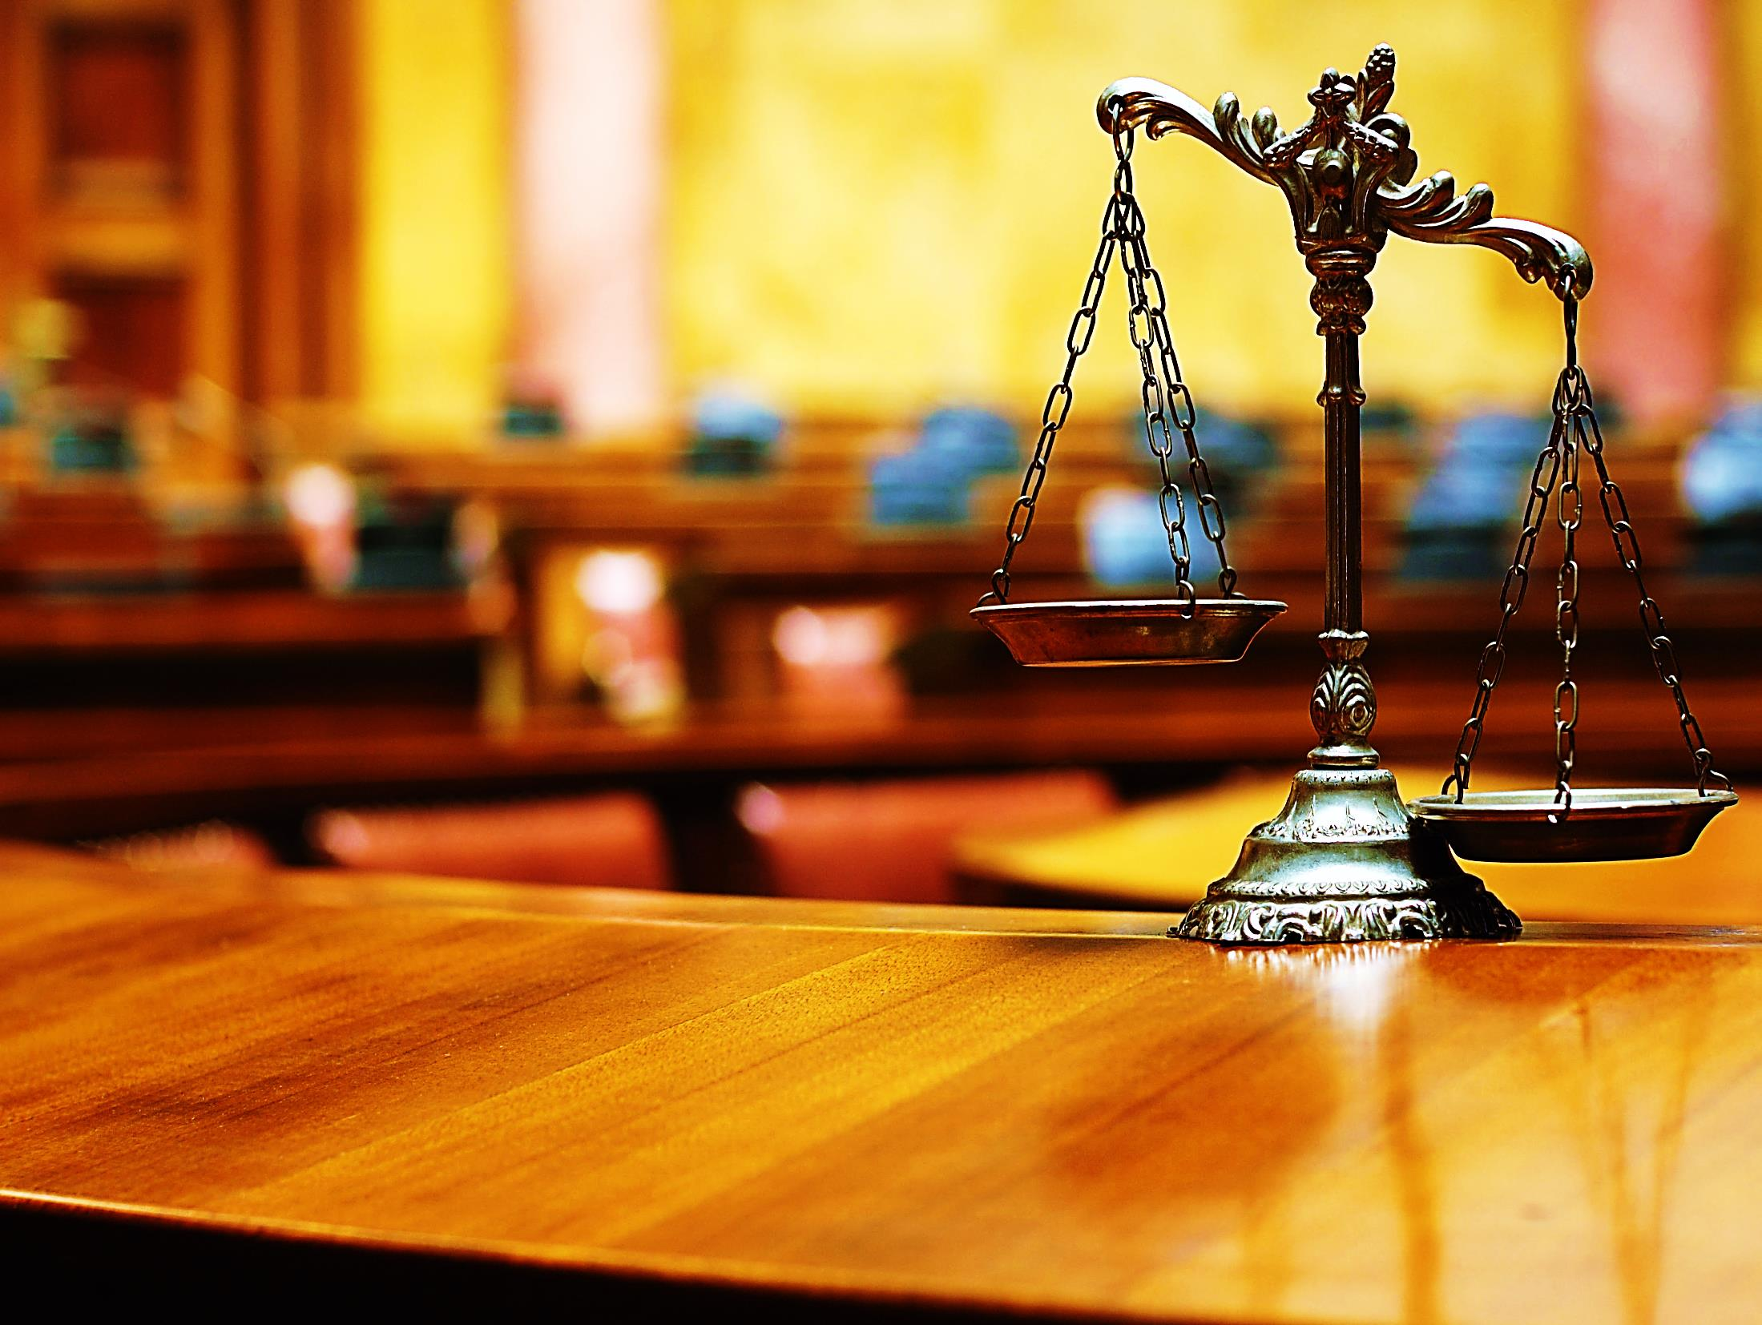
The Legal
System
The Judge
The Charge
The Penalty
Potential Legal Defenses
Plea Agreement or Trial

Slide 7
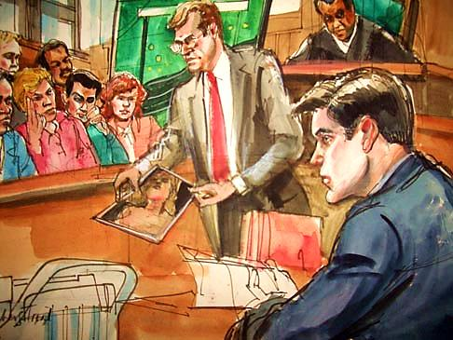
The Prosecutor
The Lord takes his place in court. He is the great prosecuting attorney… Isaiah 3:13-15

Slide 8
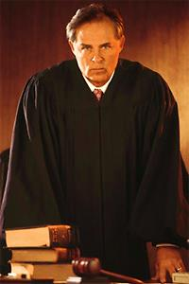
The Judge
“I saw all the dead people standing before God. There were great people and small people. The books were opened.” Revelation 20:12
“We will all stand before God to be judged by Him.” Rom. 14:10

Slide 9
The Judge
Knows everything

Slide 10
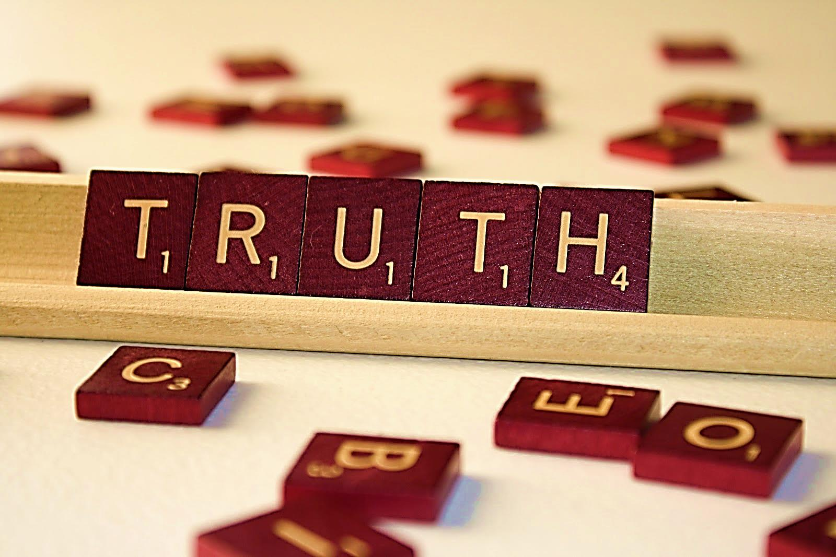
The Judge
Does not lie
“God, who cannot lie…” Titus 1:2

Slide 11
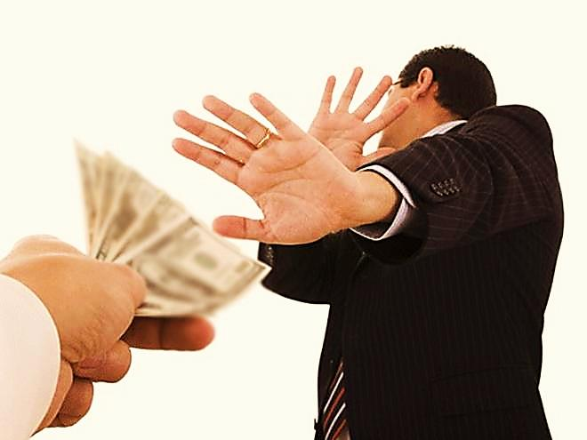
The Judge
Cannot be bribed

Slide 12
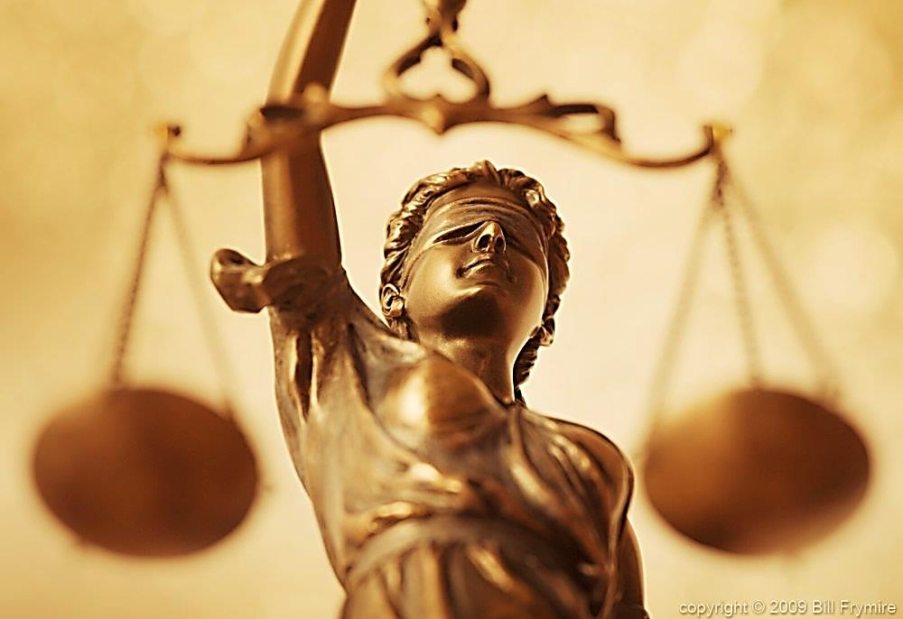
The Judge
Has no favorites
“For there is no partiality with God”
Rom. 2:11

Slide 13
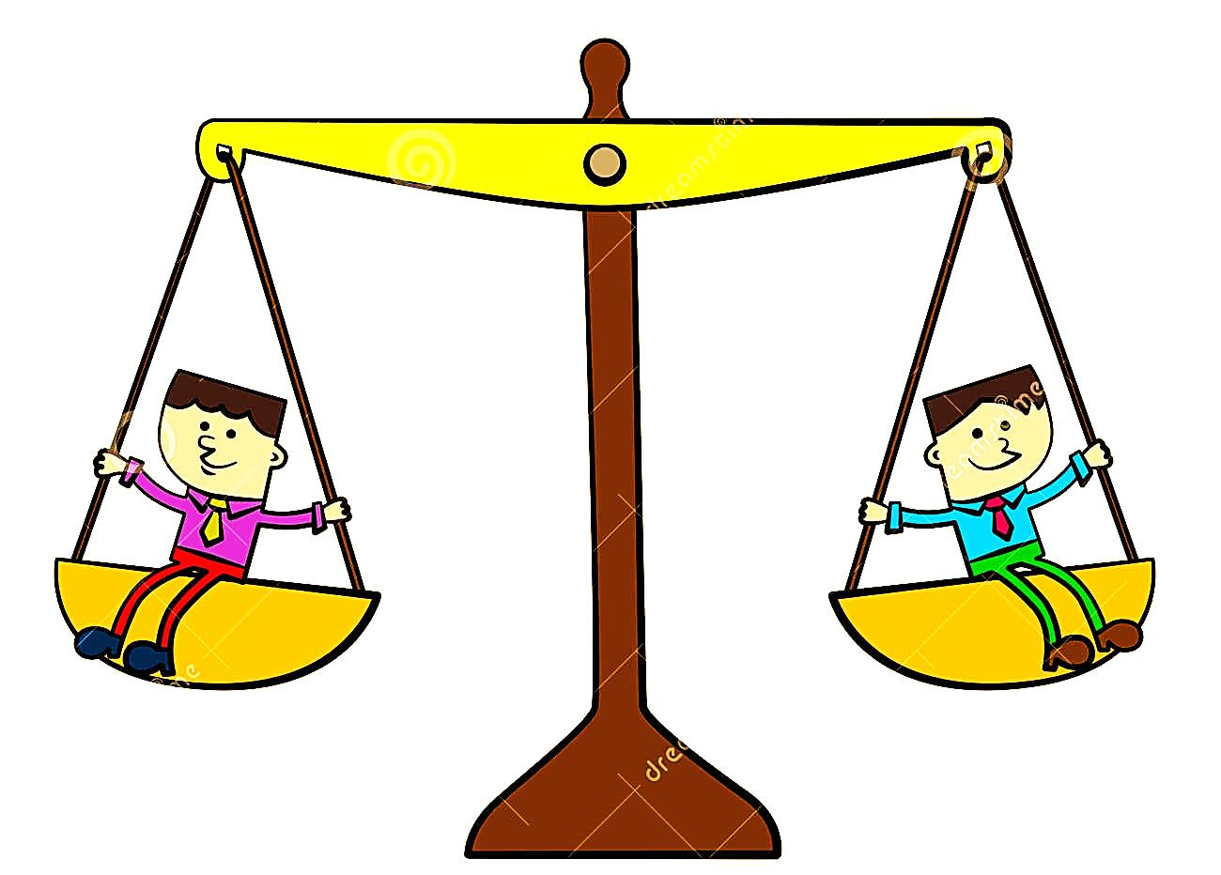
The Judge
Perfectly Fair
“He is coming to say who is guilty or not on the earth. He will be right in what He decides…”
Psalm 96:13

Slide 14
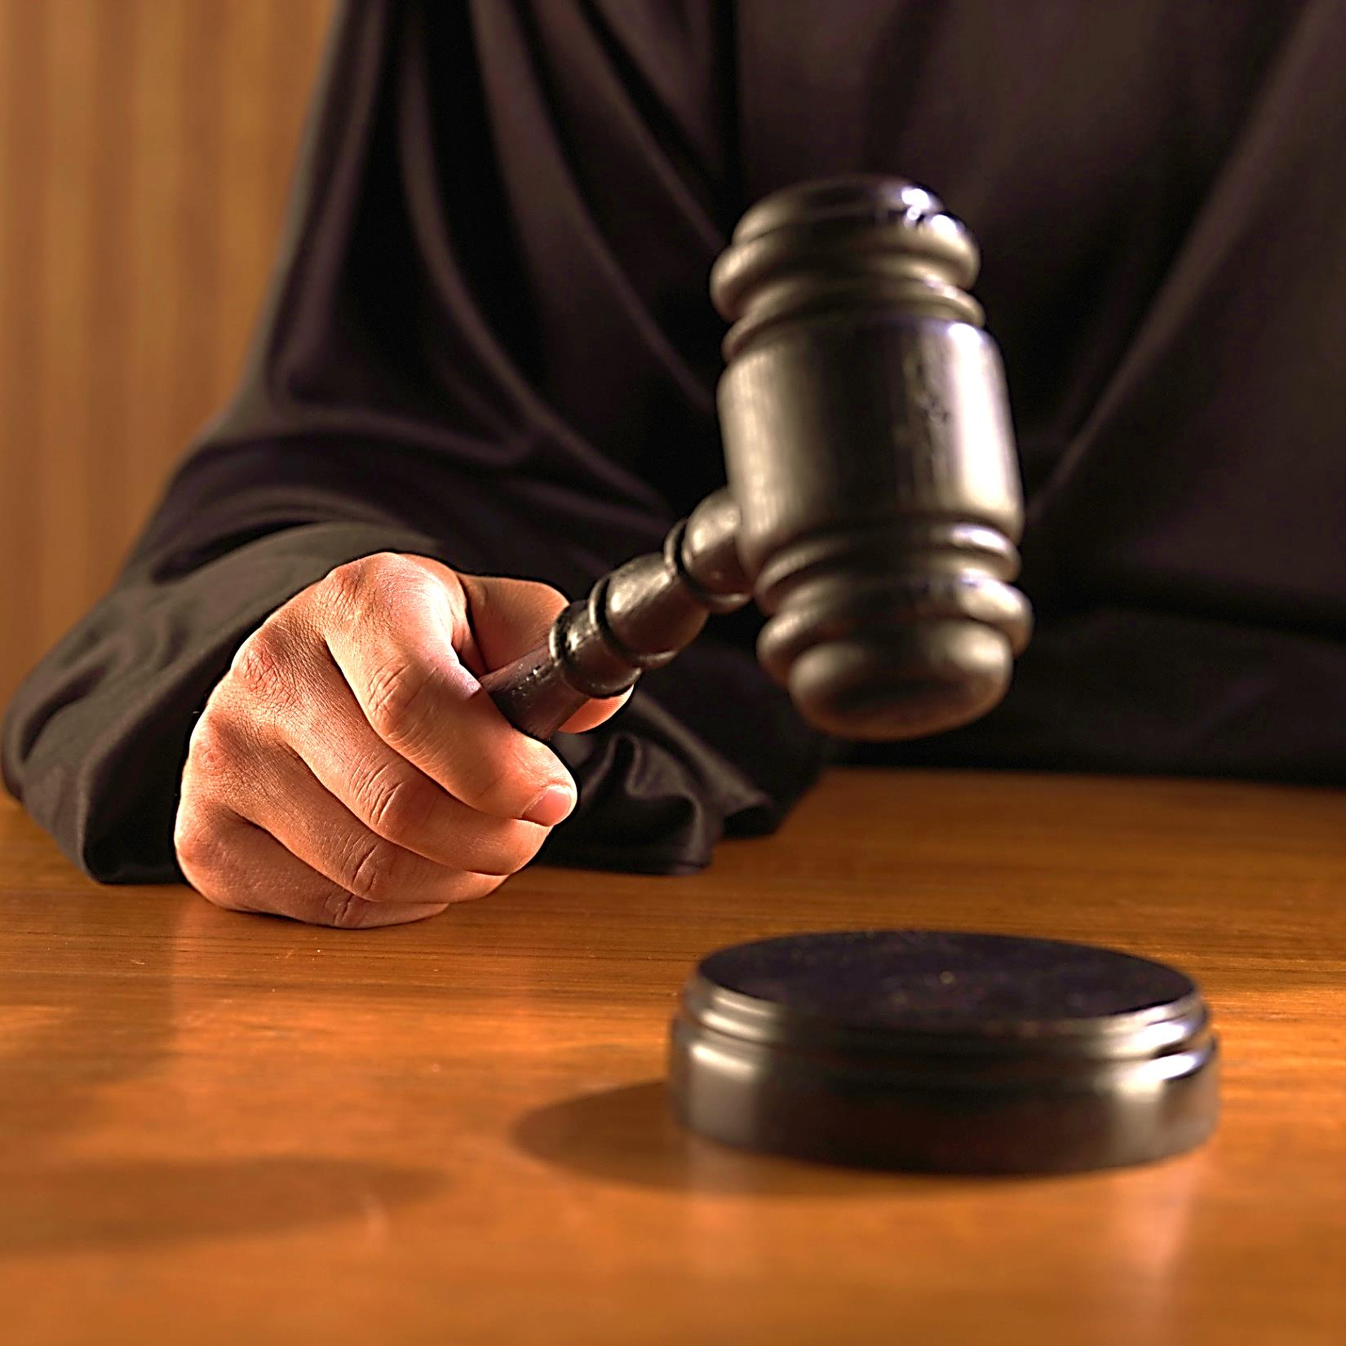
The Judge
“Nothing is more destructive of respect for the government and the law of the land than passing laws which cannot be enforced.”
Albert Einstein
Holy and Wrathful

Slide 15
“I say to you, My friends, do not be afraid of those who kill the body and then can do no more. I will
tell you the one to be afraid of. Be afraid of Him Who has power to put you into hell… Lk. 12:4,5

Slide 16
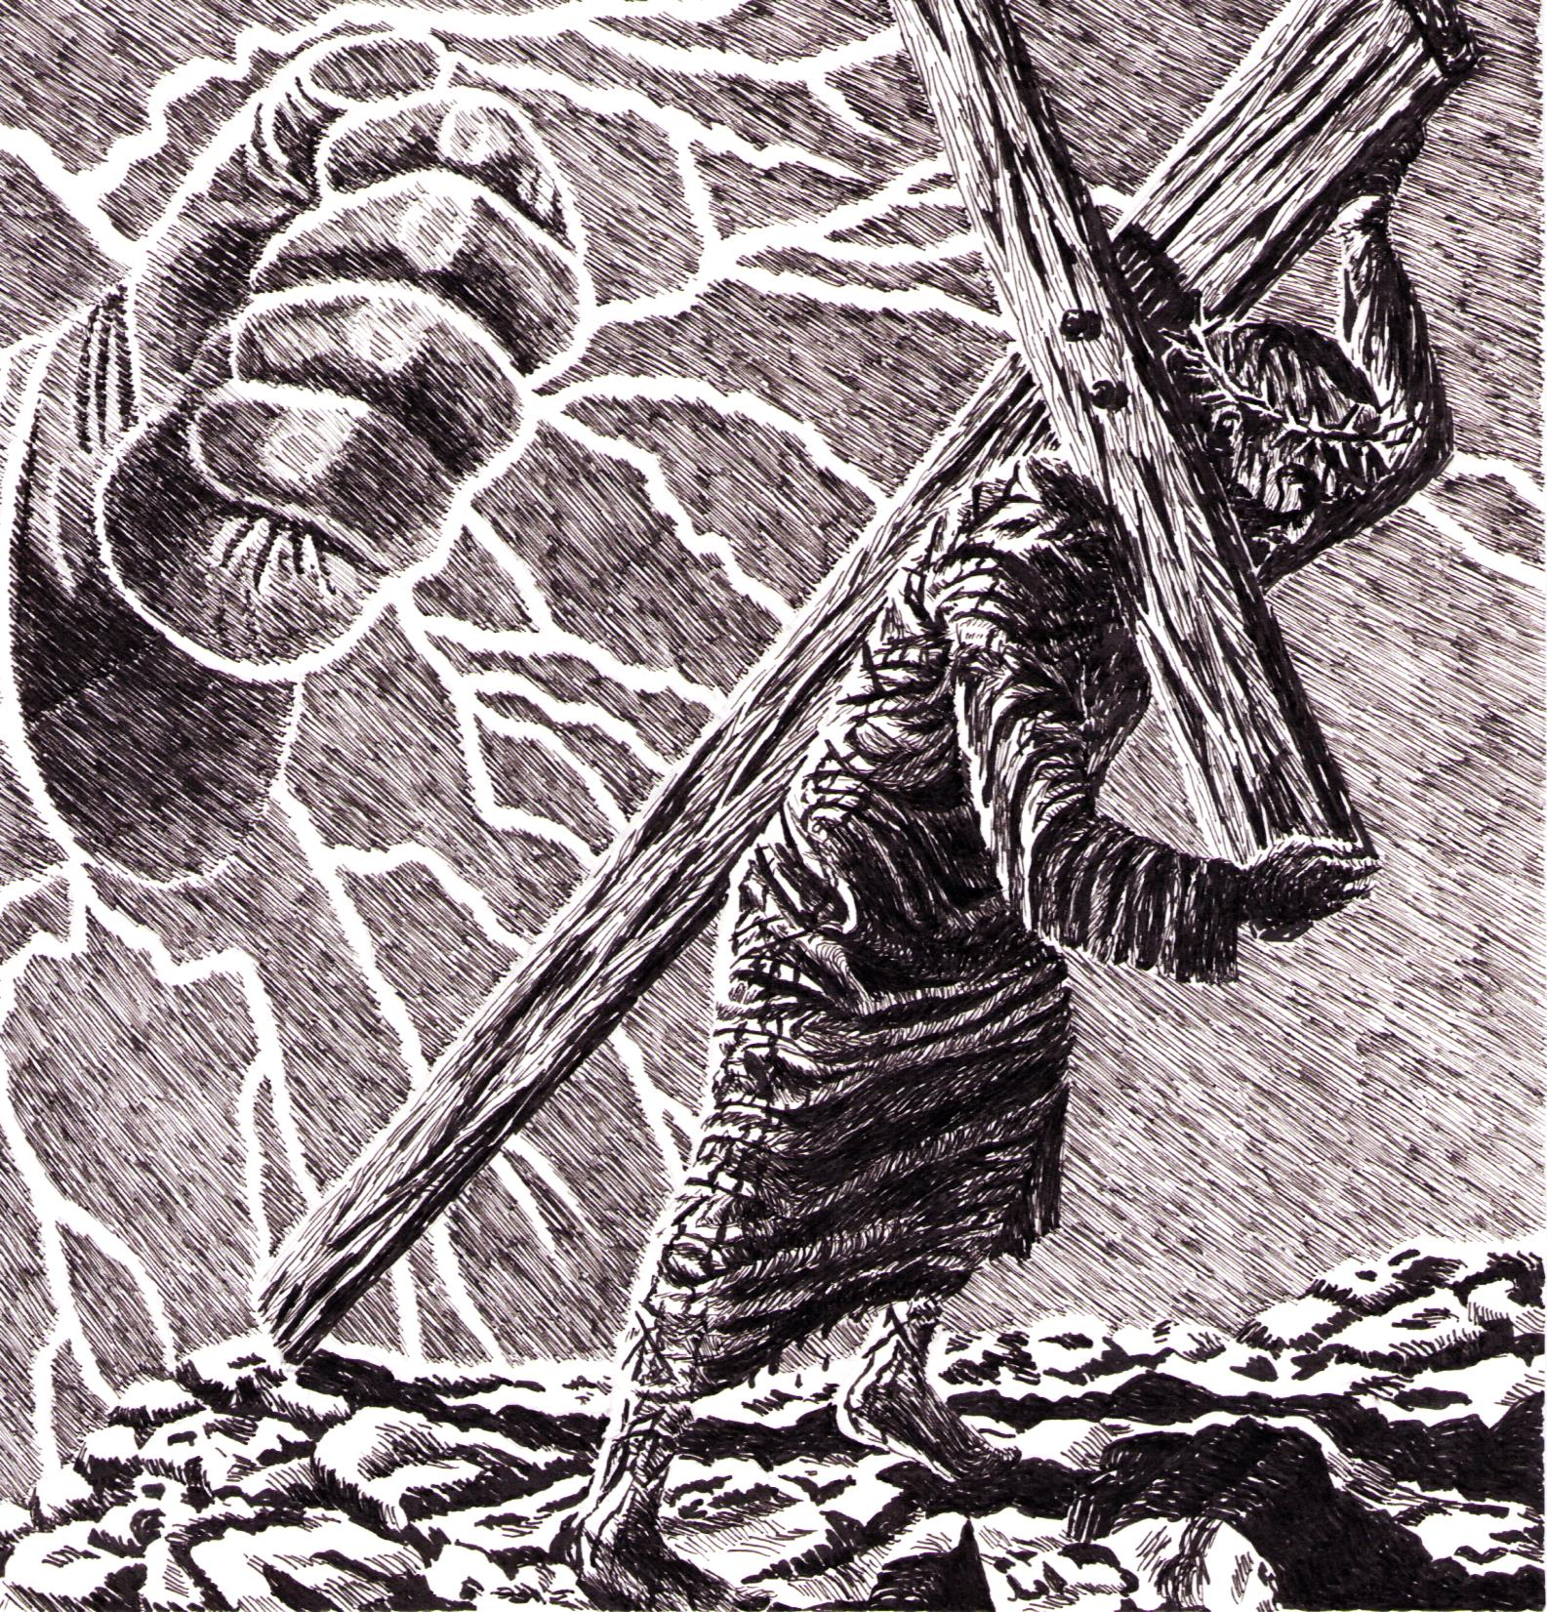
“We see the anger of God coming down from heaven against all the sins of men…”
Rom. 1:18
God’s full wrath was released upon Jesus Christ at Calvary!
If we refuse this provision, we are choosing to bear our own penalty.

Slide 17
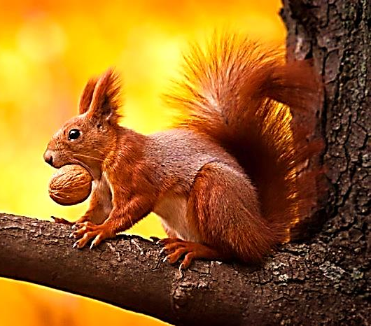
“You are storing up wrath for yourself because of your stubbornness and your heart that refuses to change. God’s just judgment will be revealed on the day of wrath.”
Rom. 2:5-6

Slide 18
“It is a terrifying thing to fall into the hands of the living God” Heb. 10:31

Slide 19
The
Judge
Full of Love and Compassion
‘As I live,’ says the Lord God, ‘I am not pleased when sinful people die. But I am pleased when the sinful turn from their way and live. Turn! Turn from your sinful ways! Why will you die…”
Ezekiel 33:11

Slide 20
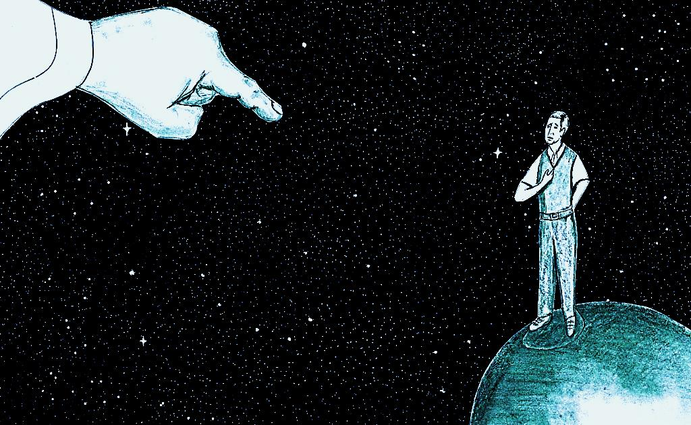
The Charge
You Have Sinned Against God
“All have done wrong and all are far from being as good as God.”
Rom. 3:23

Slide 21
Two Options
Plead Guilty→ Plea Agreement
Plead Not Guilty→ Trial

Slide 22
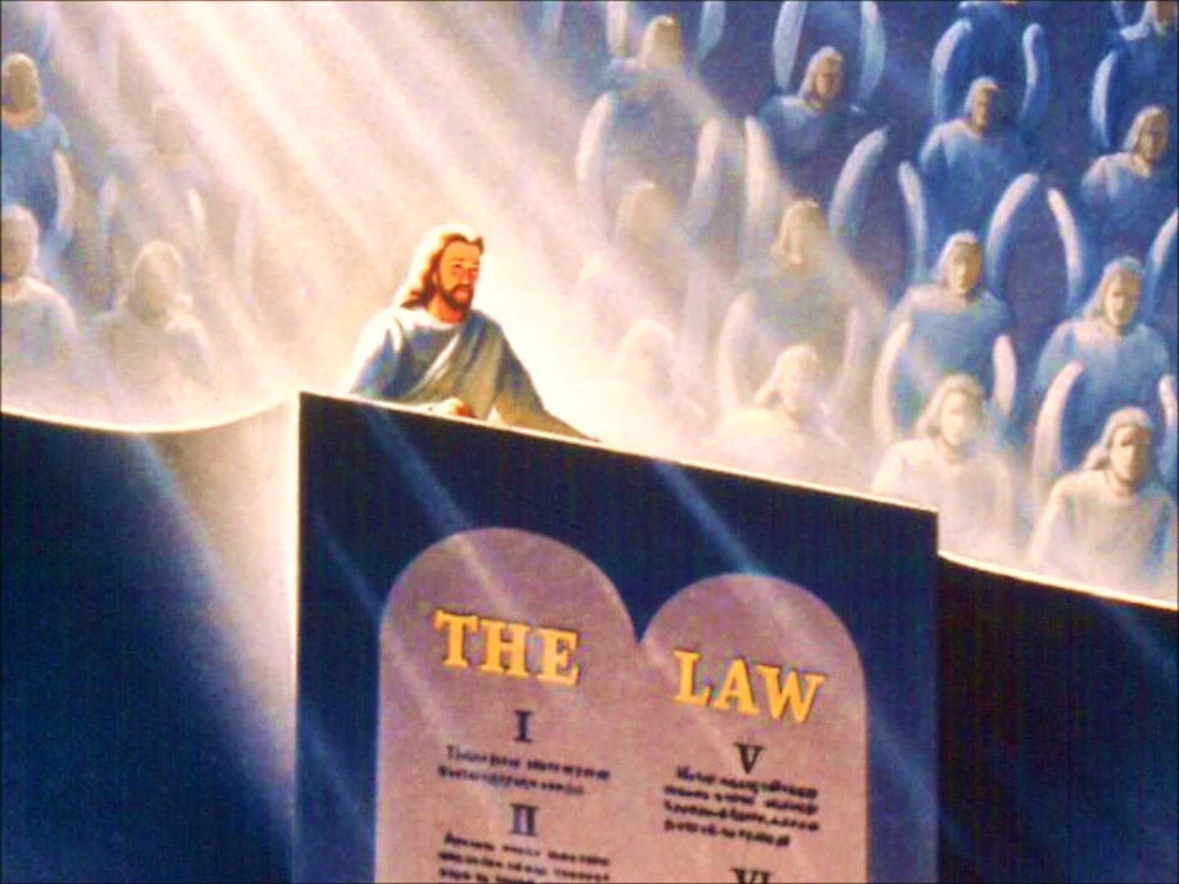
Your trial will not take place behind closed doors.
God wants to establish that
He is righteous,
and fair. His judgments are perfect and flawless.
Public Trial

Slide 23
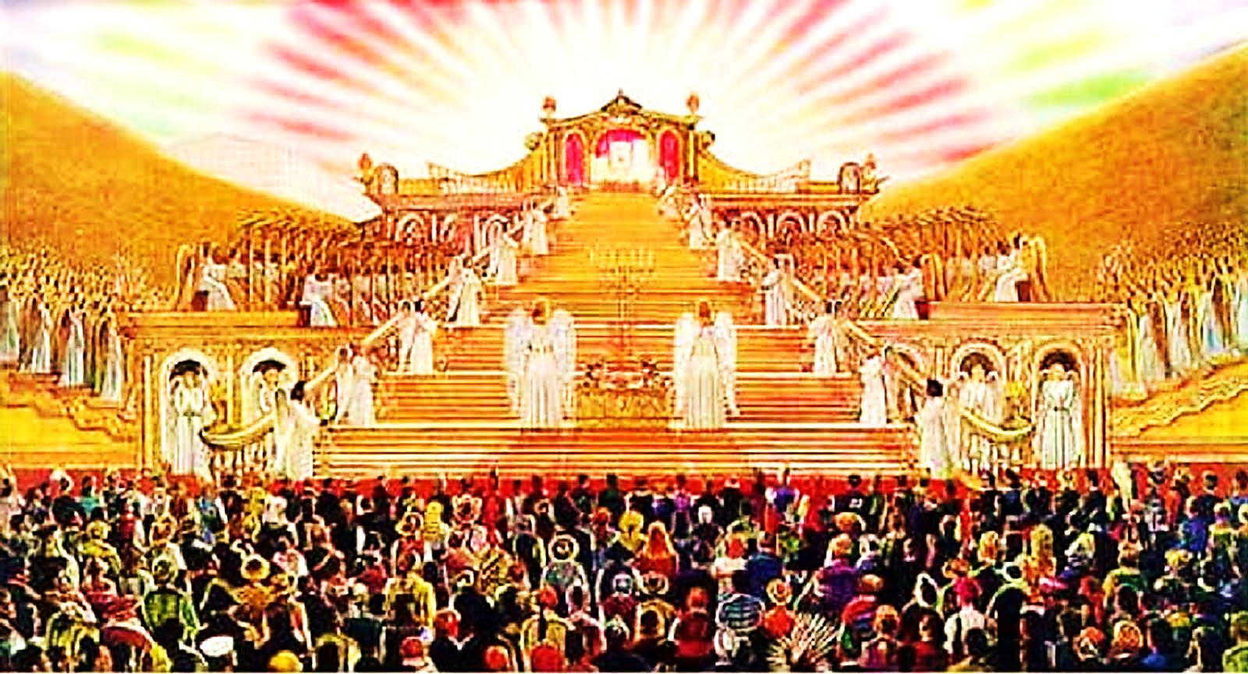
“Then I saw a great white throne. I saw the One Who sat on it… I saw all the dead people standing before God. There were great people and small people.
Rev. 20:11, 12

Slide 24
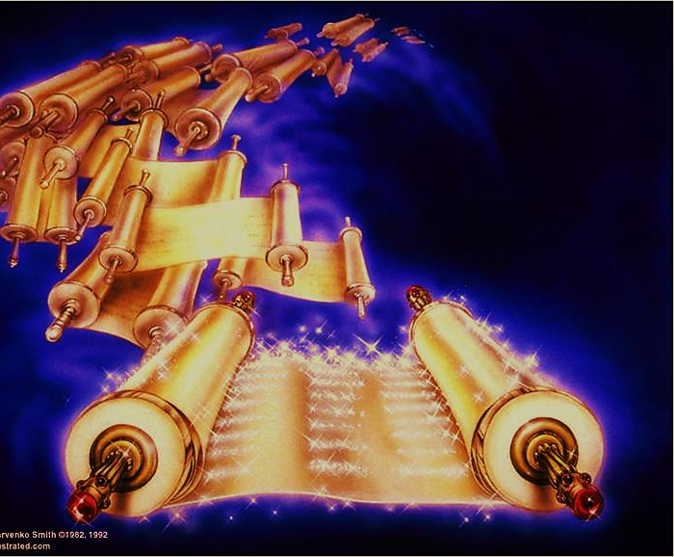
“…Then another book was opened. It was the book of life. The dead people were judged by what they had done as it was written in the books. ” Rev. 20:11, 12

Slide 25
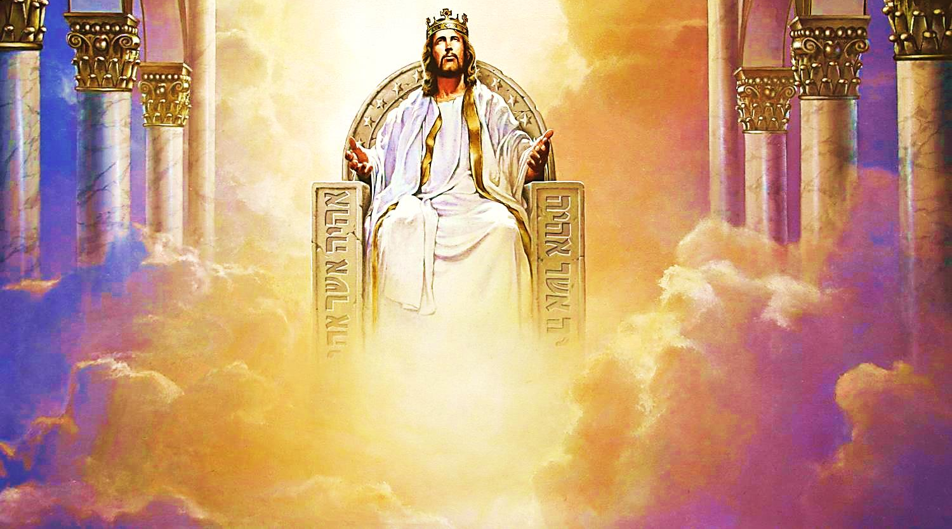
“…the One Who has lived forever took His seat. His clothing was as white as snow… many millions were standing before Him. The Judge was seated, and The Books were opened.” Dan. 7:9-11

Slide 26
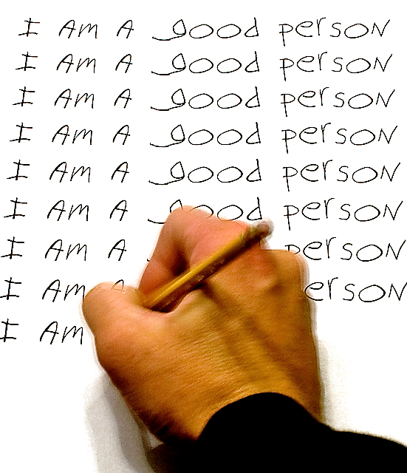
Potential Defense #1
Deny the Extent of Your Sin

Slide 27
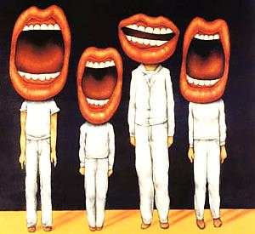
“And I say to you, that every careless word that men shall speak, they shall render account for it in the day of judgment”
Mat. 12:36

Slide 28
“There will be a day when God will judge because He knows the secret thoughts of men…” Rom. 2:16
“He will bring into the light the things that are hidden in men’s hearts. He will show why men have done these things.” 1 Cor. 4:5

Slide 29
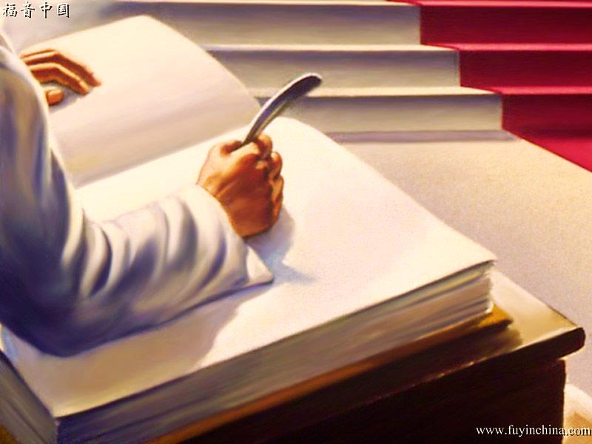
“The dead were judged from the things which were written in the books, according to their deeds”
Rev. 20:12

Slide 30
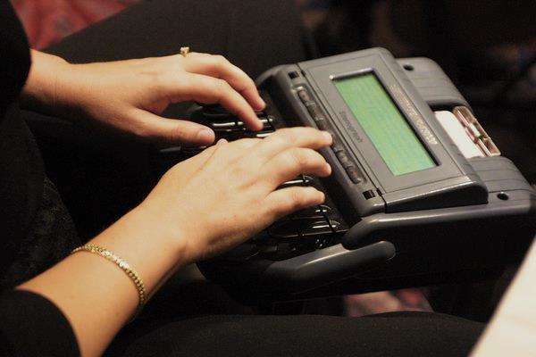
In God’s courtroom, every thought ,deed and word has been recorded and will be read back in public.

Slide 31
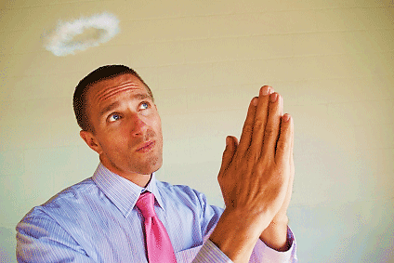
Potential Defense #2
Compare Yourself To Really Bad People

Slide 32
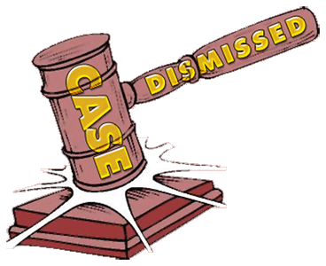
We think we are good enough to just have our case thrown out of court.

Slide 33
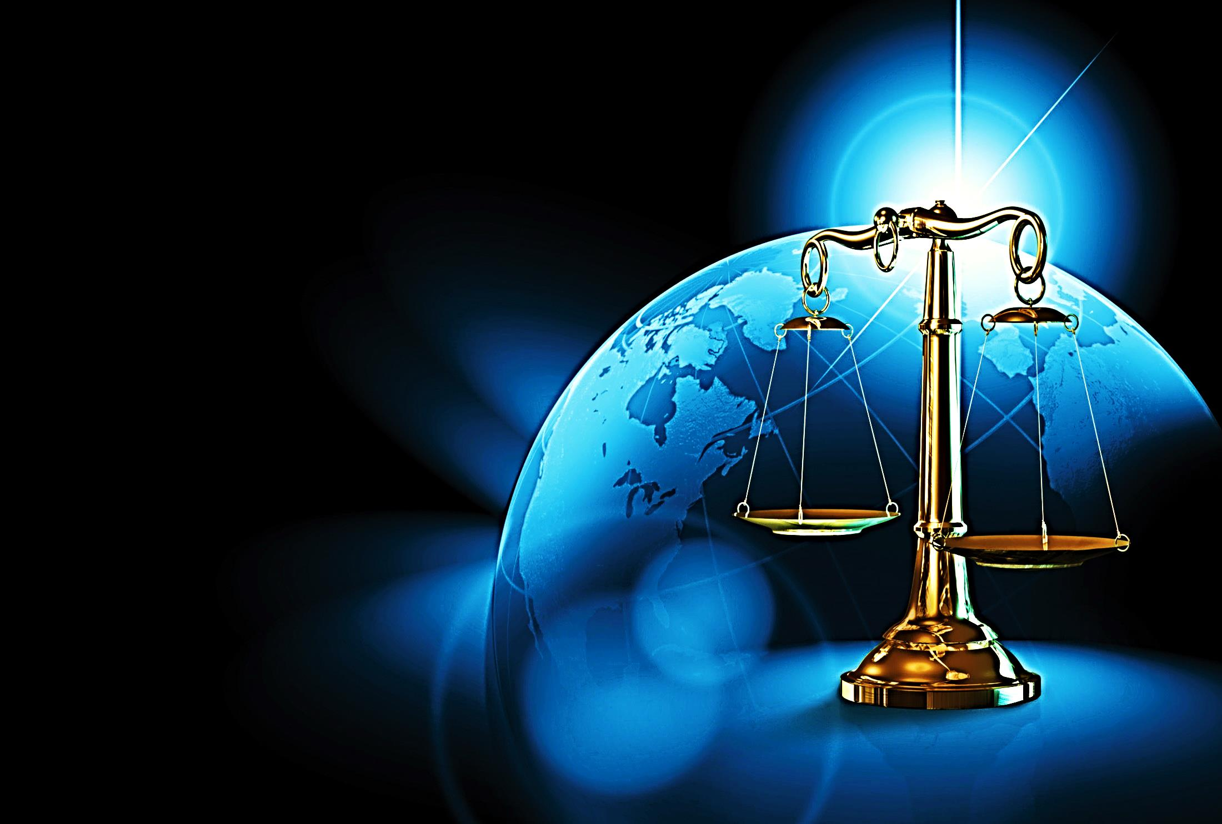
One Sin Equals Conviction
“For whoever keeps the whole law and yet stumbles in one point, he has become guilty
of all” Jam. 2:10

Slide 34
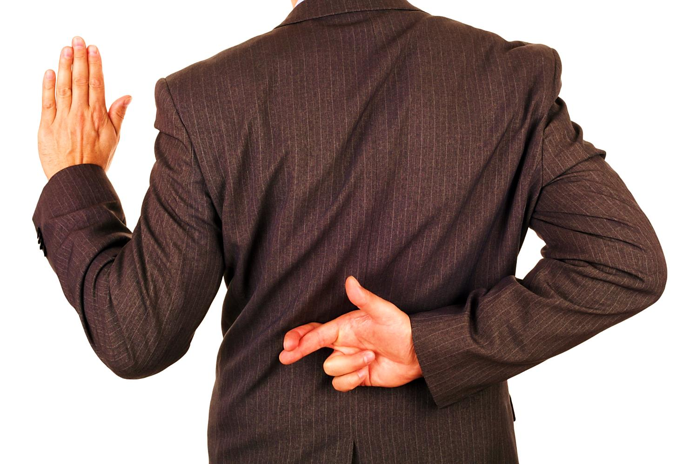
“A man who tells lies about someone will be punished. He who tells lies will not get away.” Prov. 19:5
“Everyone who is proud in heart is a shame to the Lord. For sure, that one will be punished.” Prov. 16:5
“Do you think God will punish others for doing wrong and let you keep sinning?” Romans 2:3
“Know for sure that the sinful man will not go without being punished.” Proverbs 11:21
“When they say, ‘Everything is fine and safe,’ then all at once they will be destroyed.” 1 Thess. 5:3

Slide 35
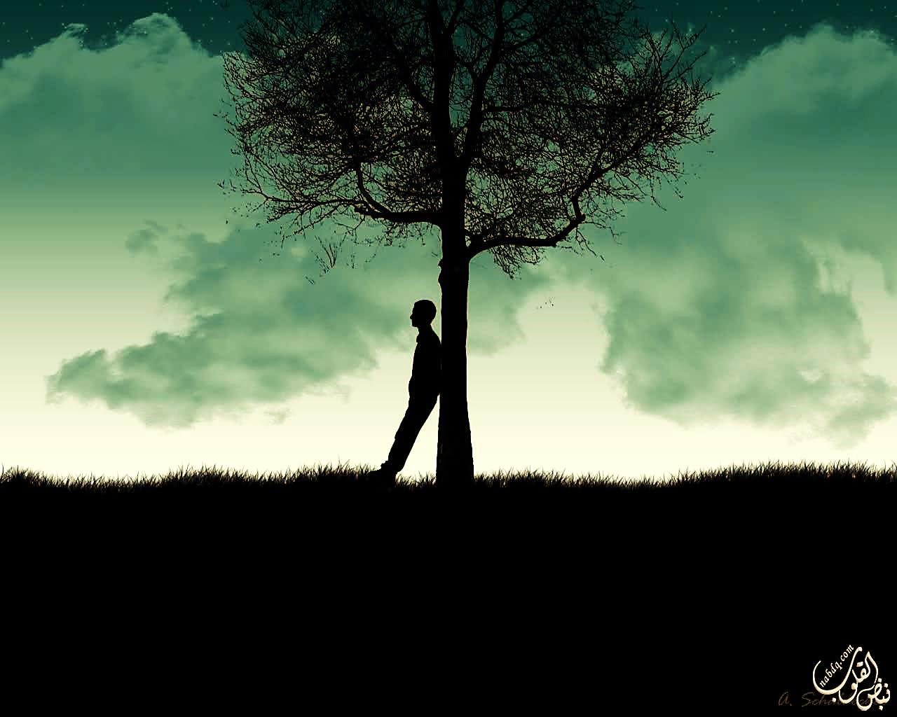
The Penalty
The penalty for the charge of sin is
Spiritual and Eternal Death.
“The soul who sins will die.” Ezek. 18:4
Sin brought death with it. Death spread
to all men because all have sinned. Rom. 5:12
But your wrong-doings have kept you
away from your God. Isa. 59:2

Slide 36
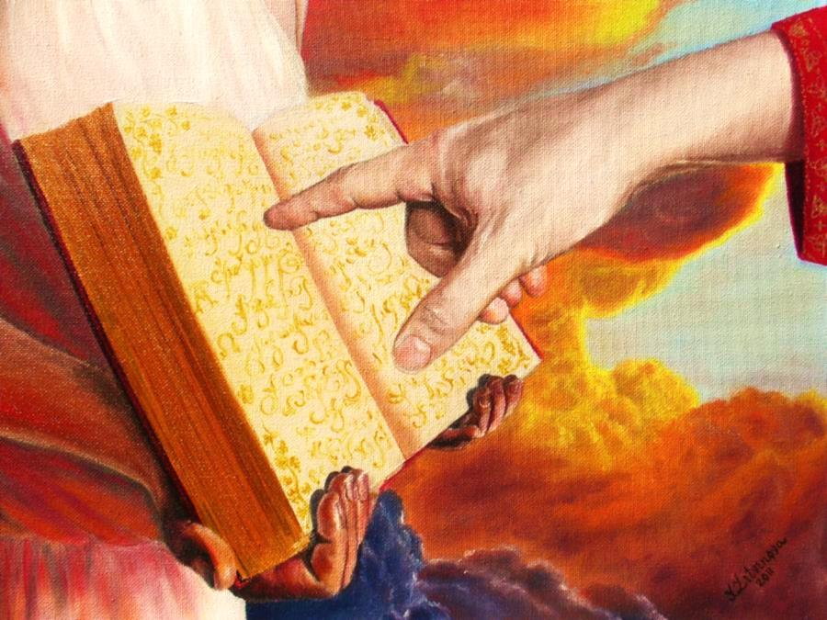
Eternal Punishment
“If anyone’s name was not written in the book of life, he was thrown into the lake of fire.” Rev. 20:15

Slide 37
Length of Sentence
“These will go to the place where they will be punished forever. But those right with God will have life that lasts forever.”
Mat. 25:46

Slide 38
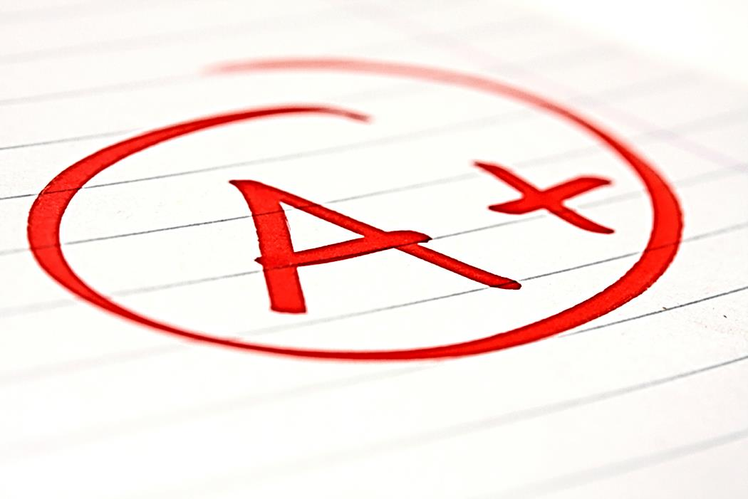
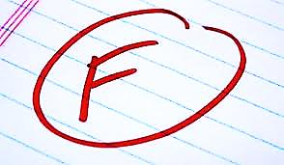
All Man’s Religions:
Merit Based – Say men can improve themselves
Honors man’s ‘spiritual’ achievements
Christianity Alone:
Mercy Based – Says man can only fail
Equally Honors God’s Love and Justice

Slide 39
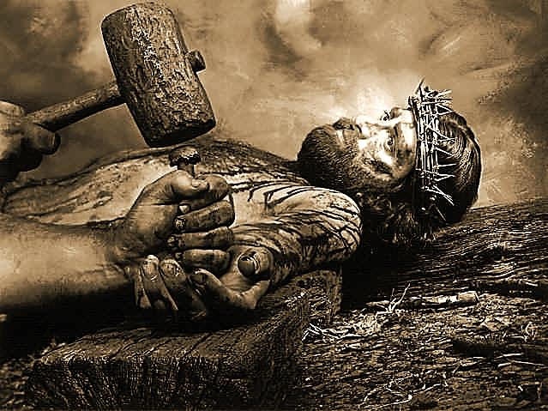
The Attorney for the Defense
Jesus Christ Paid Our Penalty
Jesus Christ was legally charged with our sin.
All of our sins were placed on Jesus Christ.
God poured out His wrath on Jesus Christ in our place.

Slide 40
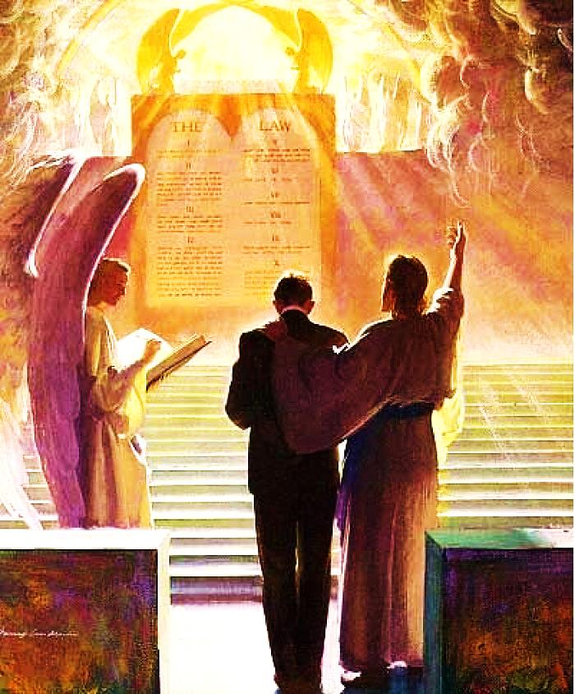
The Attorney for the Defense
“There is one Man standing between God and men. That Man is Christ Jesus.” 1 Tim. 2:5
“He went to heaven itself and He is before God for us.” Heb. 9:24

Slide 41
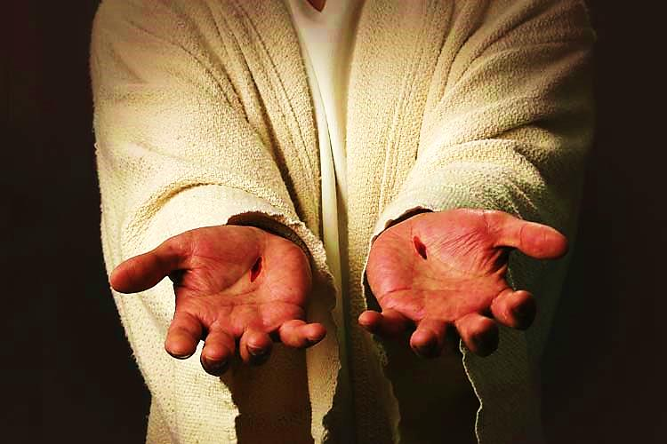
Evidence for the Defense
“But if anyone does sin, there is One Who will go between him and the Father. He is Jesus Christ, the One Who is right with God.” 1 John 2:1

Slide 42
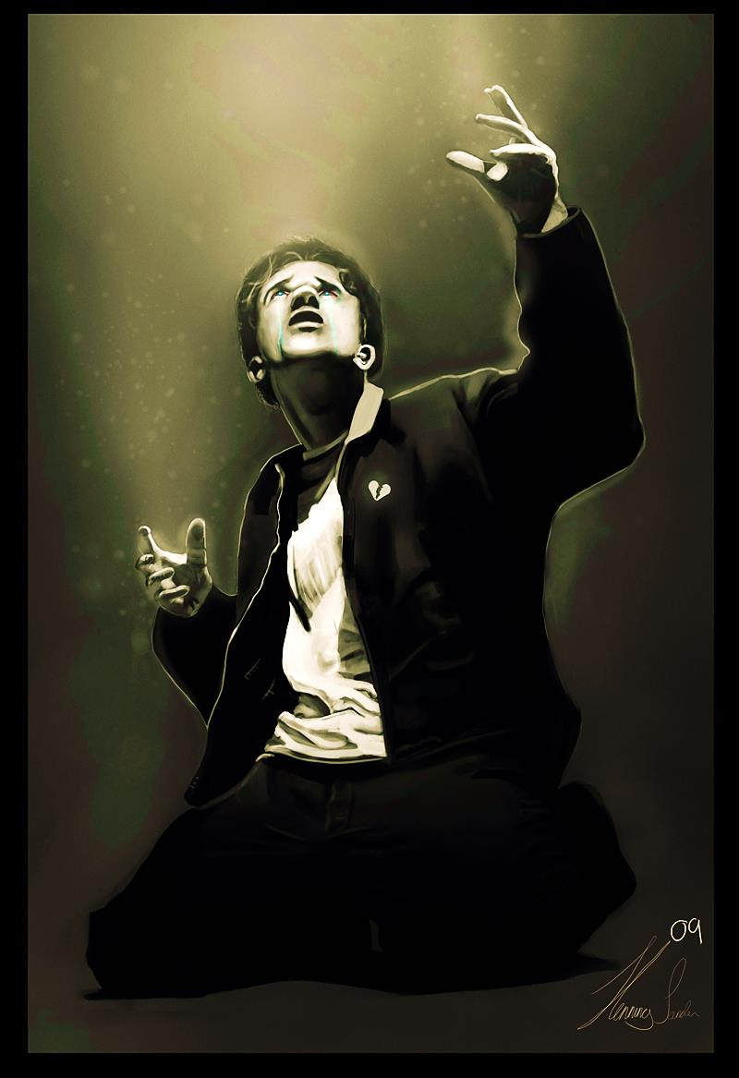
Pardon Conditions
Admit You have broken God’s laws.

Slide 43
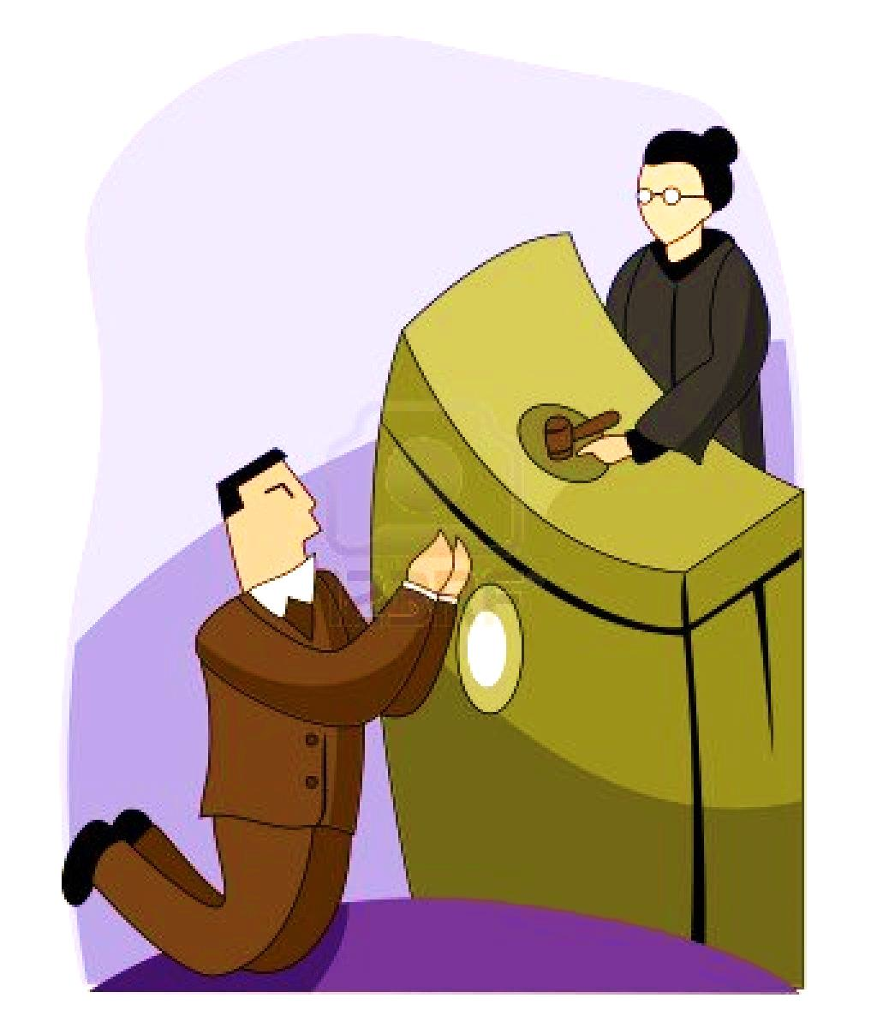
We can only throw ourselves on the mercy of the court!

Slide 44
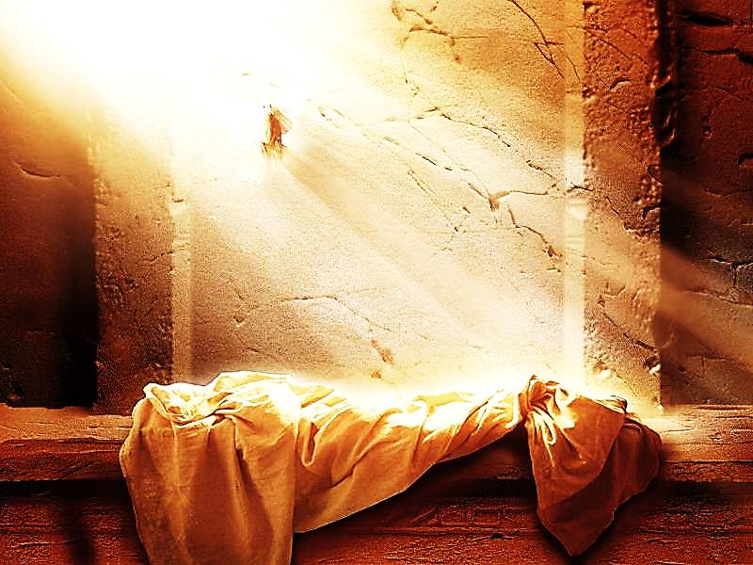
Pardon Conditions
Believe - The Penalty of Sin is eternal death. - Jesus Christ shed His blood, died on a cross and arose from the dead.

Slide 46
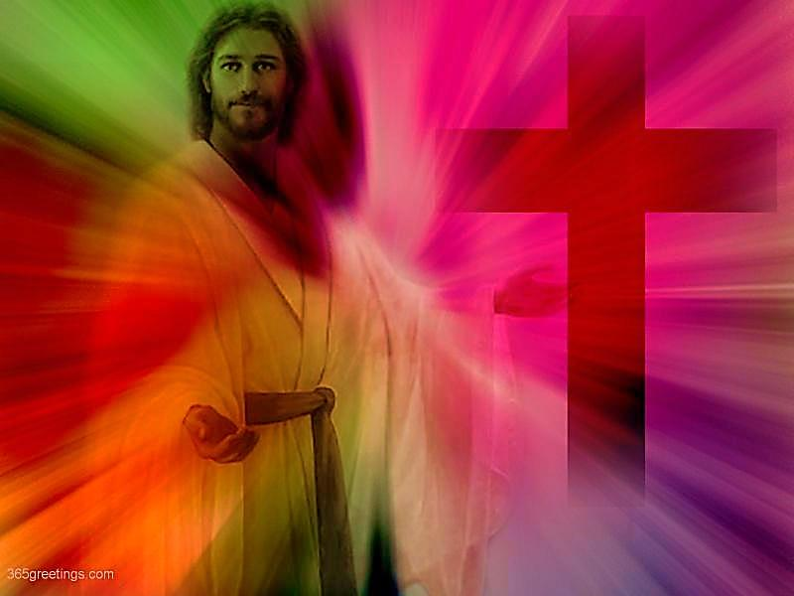
Pardon Conditions
Commit - Confess Jesus Christ as Lord. - Repent of your sins.

Slide 47
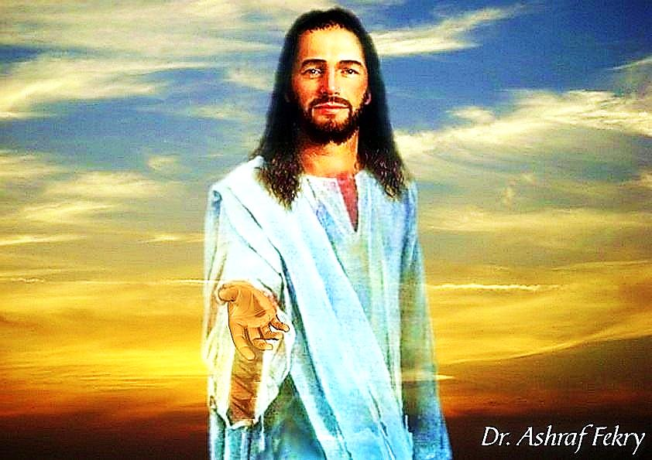
“God was so good to make a way for us to be saved from the punishment
of sin…
What makes us think we will not go to hell if we do not take the way to heaven that He has made for us?” Heb. 2:3

Slide 48
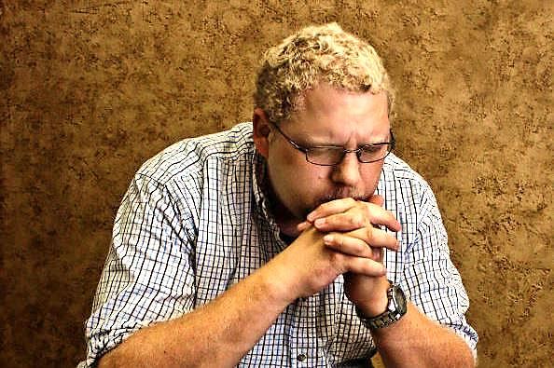
“If we confess our sins, He is faithful and righteous to forgive us our sins...” 1 John 1:9
“But unless you repent, you will all likewise perish” Luke 13:5

Slide 49
Next Slide: Song – Were it not for Grace Download Here: http://youtu.be/5u9q69c9PEs

Slide 50
Is Jesus Speaking to You?
“They said to each other, ‘Did not our hearts burn within us while he talked to us on the road, while he opened to us the Scriptures?’”
John Wesley Said:
“…the preacher was describing the change which God works in the heart through faith in Christ and I felt my heart strangely warmed.”
Jesus makes His presence Known by a small voice!

Slide 52
What is the Sinner‘s Prayer?
This is a prayer we can pray when we are ready to admit we are sinners and need Christ’s forgiveness.
It must be prayed with faith in our hearts and a readiness to have a life-changing encounter with Jesus Christ.

Slide 53
A prayer of faith → Pray this prayer if :
If you never have before
You have in the past, but you think it would mean more today
You have been walking afar off and you want to come back
You want to set an example & show others how it is done
You just like to give your heart to Jesus again & again
Faith

Slide 54
We Declare Our Faith Publicly Because Jesus Declared His LOVE Publicly
“If you stand before others and are willing to say you believe in me, then I will tell my Father in heaven that you belong to me.” Mat 10:32

Slide 55
Important Questions
Do you want to know Jesus as your Savior right now?
Do you believe He died to save you from your sins & that He rose from the dead?
Do you believe that He is here, waiting to save you right now?

Slide 56
The Prayer of a Sinner Turning to Jesus
Dear Jesus, I know that I have sinned against You and that my sins separate me from You.
I am truly sorry.
Right now, I turn away from my sinful past .
Please forgive me, and help me to keep from sin.
I believe You died for my sins.
I Believe You rose from the dead, you are alive, and you hear this prayer from my heart.
I invite You Jesus to be both my Savior and the Lord of my life.
I want You to rule my life from now on.

Slide 57
“But some people did accept him. They believed in him, and he gave them the right to become children of God.”
John 1:12

Slide 59
“If you openly say, ‘Jesus is Lord’ and believe in your heart that God raised him from death, you will be saved.”
Rom. 10:9
What did you learn today?
What is the meaning of the name-tag?
What have you been thinking about God lately?
What do you want to tell the world about Jesus?

Slide 60
“Draw near to God, and He will draw near to you…
Altar Time
…Cleanse your hands, you sinners, and make your hearts pure, you who are half-hearted towards God.” James 4:8 WNT

Slide 61
Close in Prayer

Slide 62
Note: Any videos in this presentation will only play online. After you download the slideshow, you will need to also download the videos from YouTube & add them back into your PowerPoint.
We present these messages at Bee Creek Park in College Station, TX. If you would like to watch the video of the service with this message, click here:
http://campaignkerusso.org/?p=10909
We would love to know more about the people who download our lessons & sermons. We invite you to email us & let us know where & how you use them.
info@ckbrazos.org

Slide 63
Welcome to Aggieland Faith Family Style Worship

Slide 64
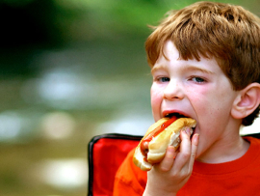
CURRENT SCHEDULE: See www.Aggielandfaith.org
SATURDAY —
At Bee Creek Park
2:00-4:00pm: Through the bible with felt-board stories – plus hot-dogs & drinks
SUNDAY —
At Bee Creek Park
2:00-4pm: Free snacks, drinks, kids crafts, prizes, singing & bible preaching

Slide 65
Would You Like Prayer or Bible Study at Your House?
Personal Prayer: We can come to your home & pray with you, or you can email us when you need prayer.
Home Bible Study: We will come to your home & hold a bible study for you & your friends.
Bible Party: We will hold a Kid’s Bible Party: You provide the food & kids - we will do the bible fun & stories.

Slide 66
Would You Like Visitation?
We will visit a friend, loved one in the hospital or in prison to pray for them & share Christ with them.
Contact: info@aggielandfaith.org

Slide 67
www.aggielandfaith.org
Go here to see pictures & videos
Go here to subscribe to e-mails about changes & cancellations

Slide 68
Note: Any videos in this presentation will only play online. After you download the slideshow, you will need to also download the videos from YouTube & add them back into your PowerPoint.
We present these messages at Bee Creek Park in College Station, TX. If you would like to watch the video of the service with this message, click here:
http://campaignkerusso.org/?p=10909
We would love to know more about the people who download our lessons & sermons. We invite you to email us & let us know where & how you use them.
info@ckbrazos.org

